Slide 1
Disclaimers
We hope you find the information on our website and resources useful.
ESL Disclaimer
This resource has been made for the purpose of teaching English language learners. We know that students can be learning English in many different places, in many different ways and at any age, so we try to keep these resources as general as possible.
There are many acronyms associated with English language teaching. These include (but are not limited to) ELT, TEFL, EFL, ELL, EAL and ESOL. While the term ESL may not fully represent the linguistic backgrounds of all students, it is the most widely recognised term for English language teaching globally. Therefore, we use the term ‘ESL’ in the names of our resources to make them easy to find but they are suitable for any student learning to speak English.
Editable
This resource is editable and can be adapted to meet the needs of different children. Twinkl cannot be held responsible for any changes made once a resource has been downloaded. Please be aware that this content may have been edited and therefore
may no longer reflect our values.

Slide 3

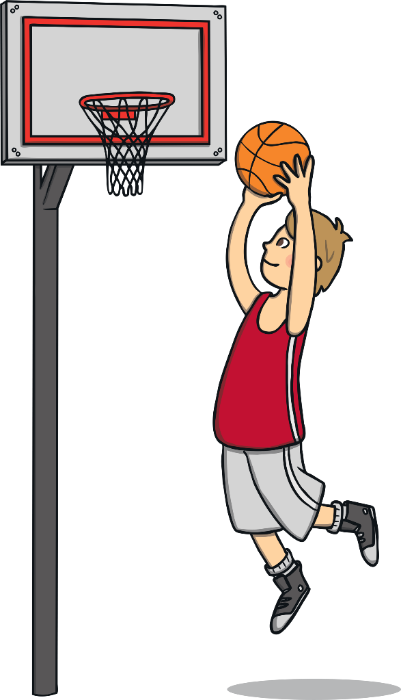

How do we say this in English?
?
basketball

Slide 4
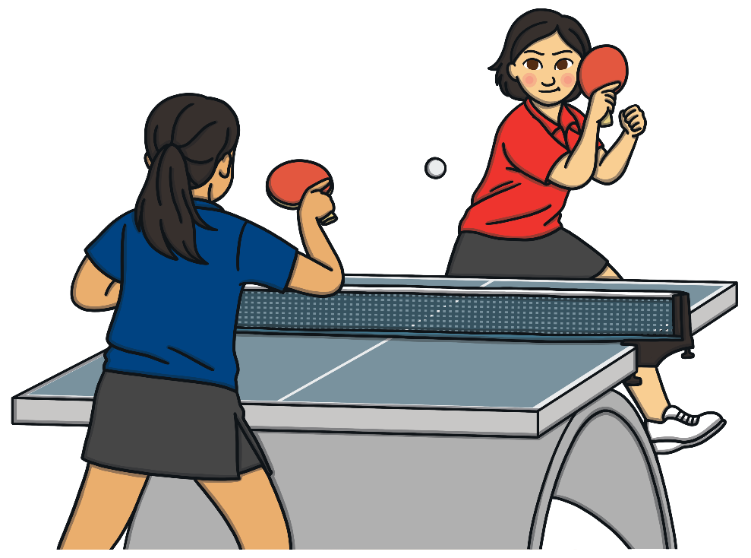
How do we say this in English?
?
table tennis

Slide 5
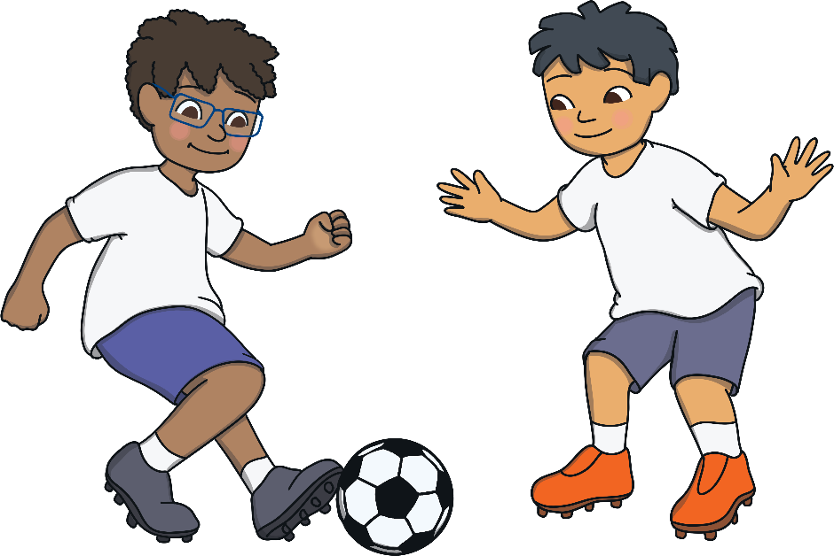
How do we say this in English?
?
football

Slide 6
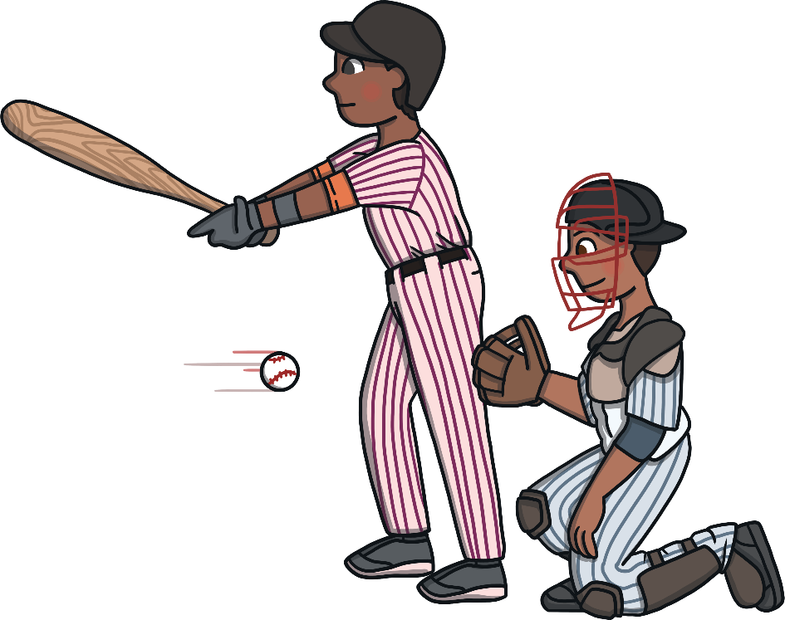
How do we say this in English?
?
baseball

Slide 7

How do we say this in English?
?
hockey

Slide 8

How do we say this in English?
?
tennis

Slide 9

How do we say this in English?
?
skateboarding

Slide 10
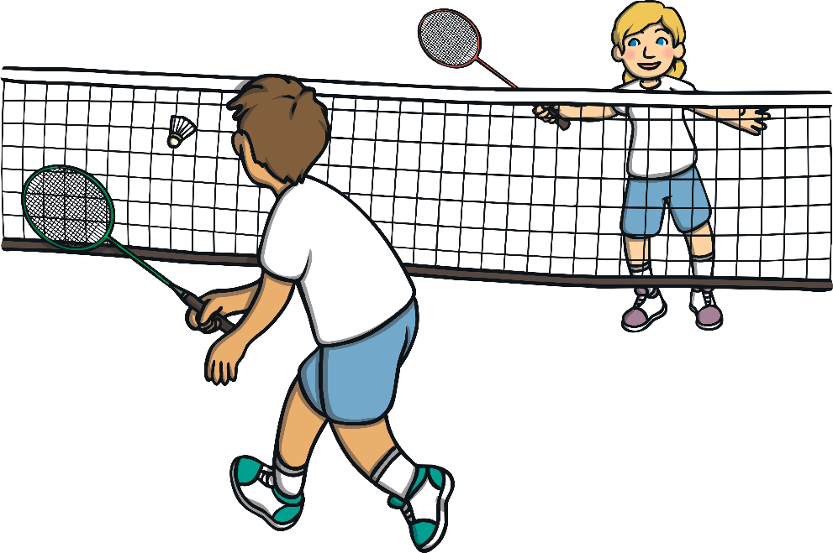
How do we say this in English?
?
badminton

Slide 11
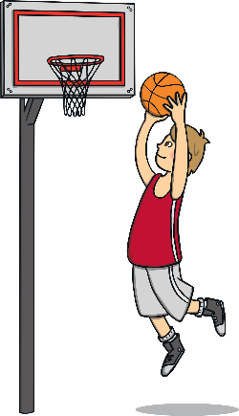




Let’s Practise!
Do you remember the name of the sports? Click to check the answer.
basketball
football
baseball
hockey

Slide 12




Let’s Practise!
Do you remember the name of the sports? Click to check the answer.
skateboarding
tennis
badminton
table tennis

Slide 13
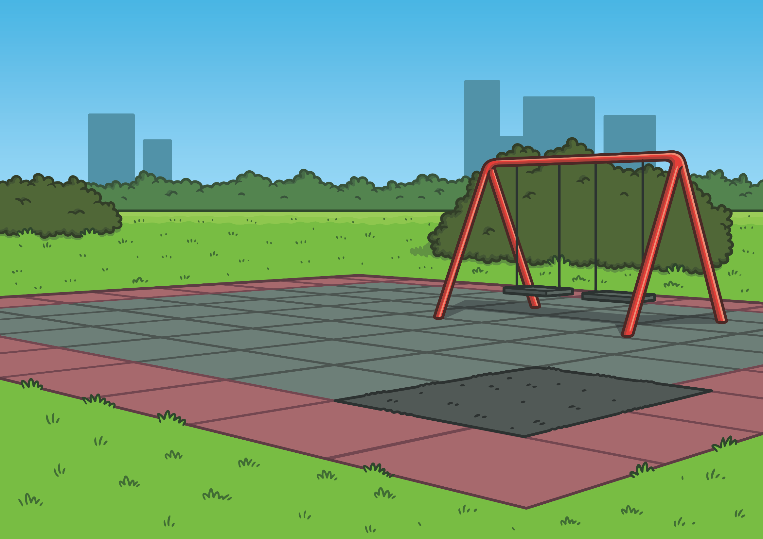




Look at the picture. What sports can you see?
badminton
football
skateboarding

Slide 14

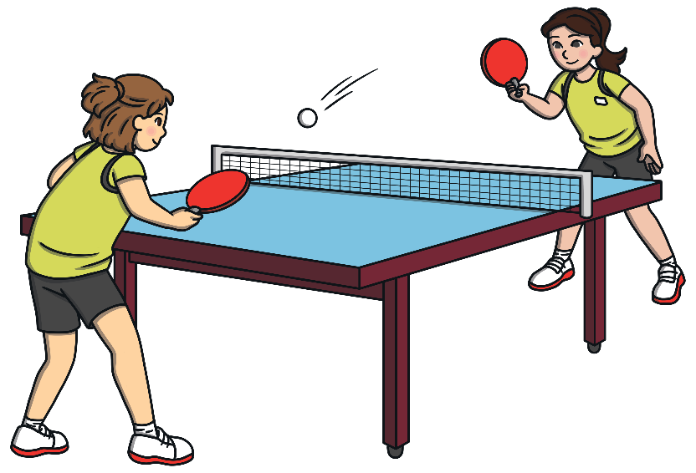

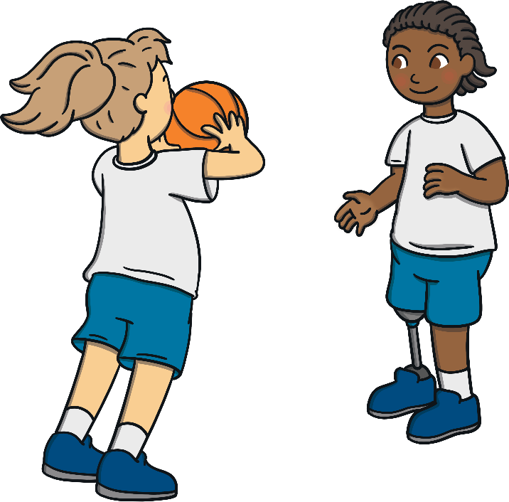
Look at the picture. What sports can you see?
table tennis
hockey
basketball

Slide 15



Look at the picture. What sports can you see?
baseball
tennis

