Slide 4


How do you say this in English?
?
book

Slide 5
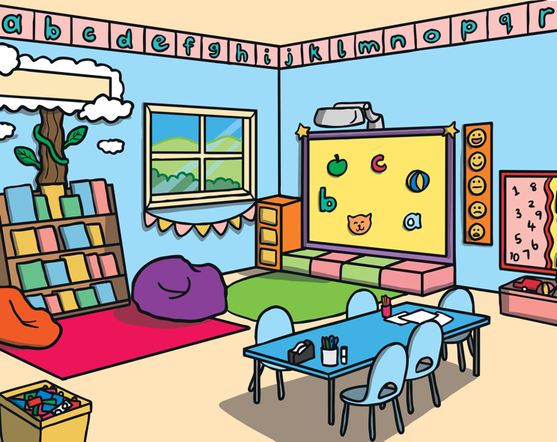
How do you say this in English?
?
classroom

Slide 6
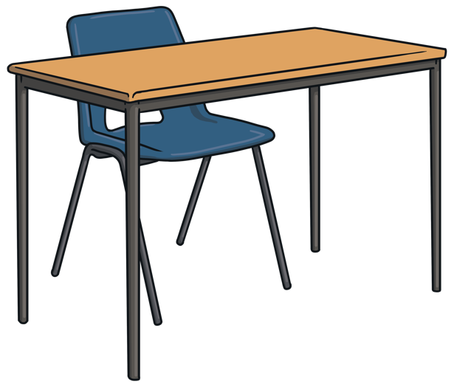
How do you say this in English?
?
desk

Slide 7

How do you say this in English?
?
computer

Slide 8

How do you say this in English?
?
pencil

Slide 9
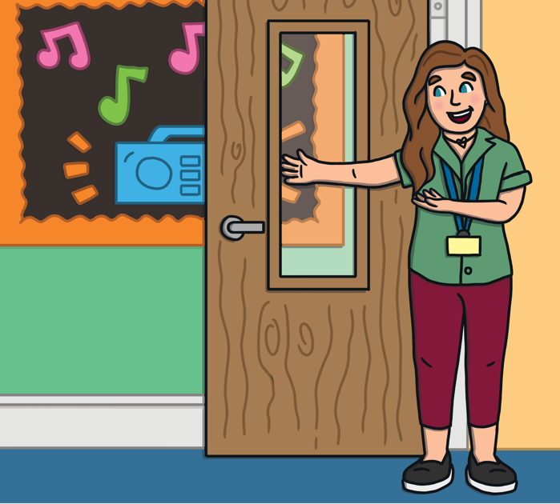
How do you say this in English?
?
teacher

Slide 10

How do you say this in English?
?
paper

Slide 11
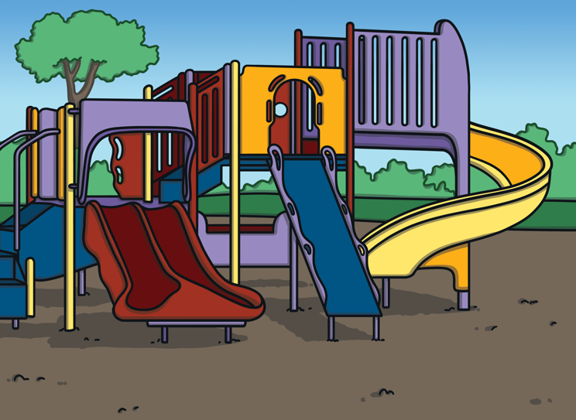
How do you say this in English?
?
playground

Slide 12

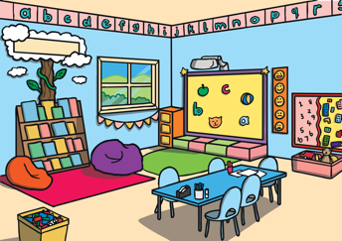


Let’s Practise!
Can you remember what these are called?
book
classroom
desk
computer

Slide 13

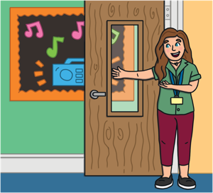

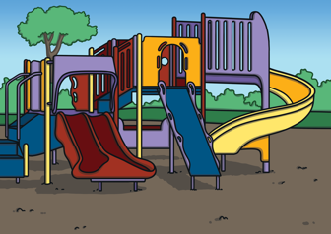
Let’s Practise!
Can you remember what these are called?
pencil
teacher
paper
playground

Slide 14
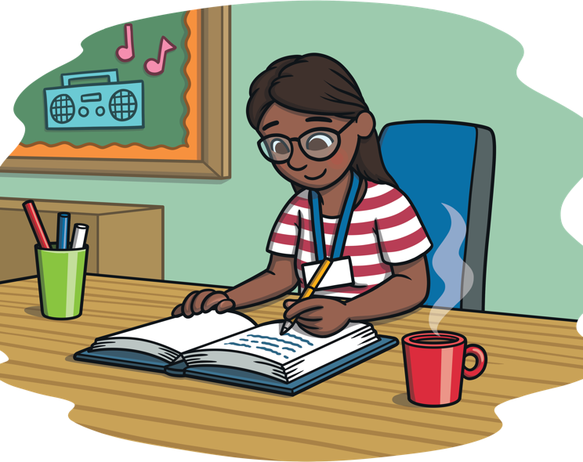
Who is this?
teacher

Slide 15
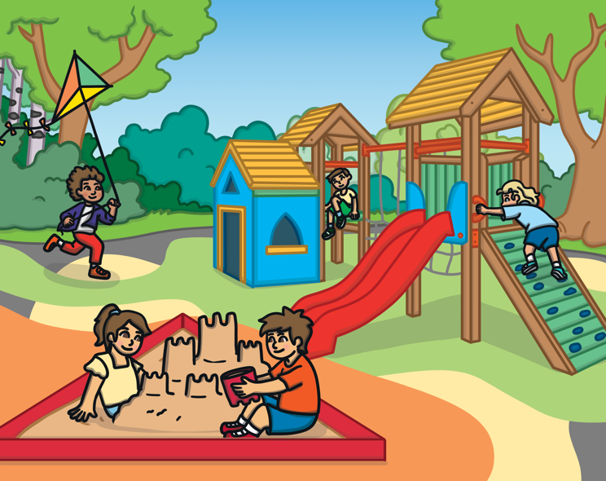
What is this?
playground

Slide 16
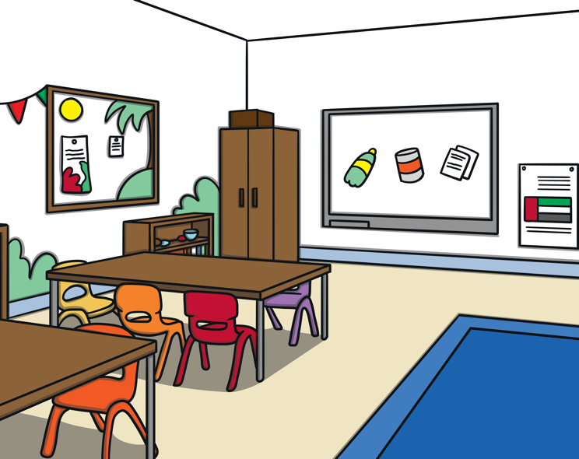
What is this?
classroom

Slide 17

What is this?
computer

Slide 18
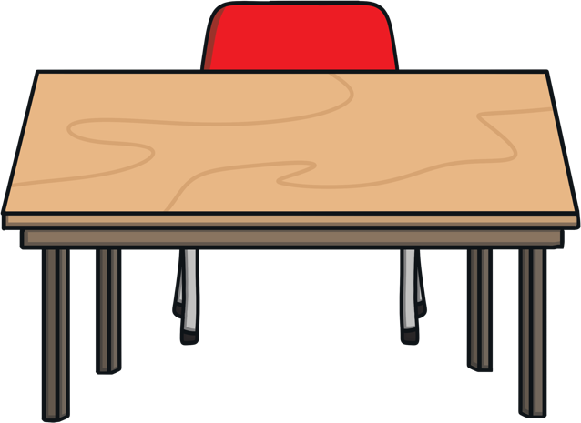
What is this?
desk

Slide 19
What is this?
pencil

Slide 20

What is this?
paper

Slide 21

What is this?
book

