Slide 1
Disclaimer
We hope you find the information on our website and resources useful.
PowerPoint
This resource has been designed with animations to make it as fun and engaging as possible. To view the content in the correct formatting, please view the PowerPoint in ‘Presentation Mode’. If you view the slides without selecting ‘Presentation Mode’, you may find that some of the text and images overlap each other or are difficult to read.
To enter ‘Slide Show Mode’, go to the ‘Slide Show’ menu tab and select either ‘From Beginning’ or ‘From Current Slide’.
Slides
This resource has been designed with animations to make it as fun and engaging as possible. To view the content in the correct formatting, please view the presentation in ‘Presenter view’. If you view the slides without selecting ‘Presenter view’, you may find that some of the text and images overlap each other or are difficult to read.
To enter ‘Slideshow Mode’, go to the ‘Slideshow’ button and select ‘Start from beginning’ or simply click ‘Slideshow’ to play from the current slide.
You may wish to delete this slide before beginning the presentation.

Slide 2
Disclaimer
We hope you find the information on our website and resources useful.
ESL Acronym
This resource has been made for the purpose of teaching English language learners. We know that students can be learning English in many different places, in many different ways and at any age, so we try to keep these resources as general as possible.
There are many acronyms associated with English language teaching. These include (but are not limited to) ELT, TEFL, EFL, ELL, EAL and ESOL. While the term ESL may not fully represent the linguistic backgrounds of all students, it is the most widely recognised term for English language teaching globally. Therefore, we use the term ‘ESL’ in the names of our resources to make them easy to find but they are suitable for any student learning to speak English.
Editable
This resource is editable and can be adapted to meet the needs of different learners. Twinkl cannot be held responsible for any changes made once a resource has been downloaded. Please be aware that this content may have been edited and therefore may no longer reflect our values.
You may wish to delete this slide before beginning the presentation.

Slide 3

Kids | Pre-A1

Slide 5

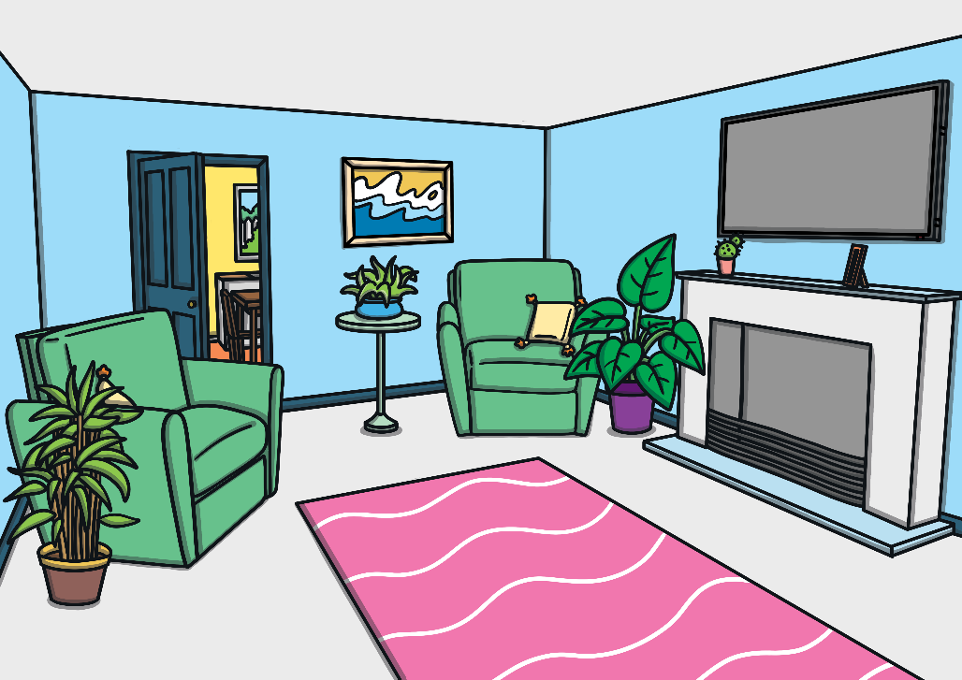

How do we say this in English?
living room
?

Slide 6
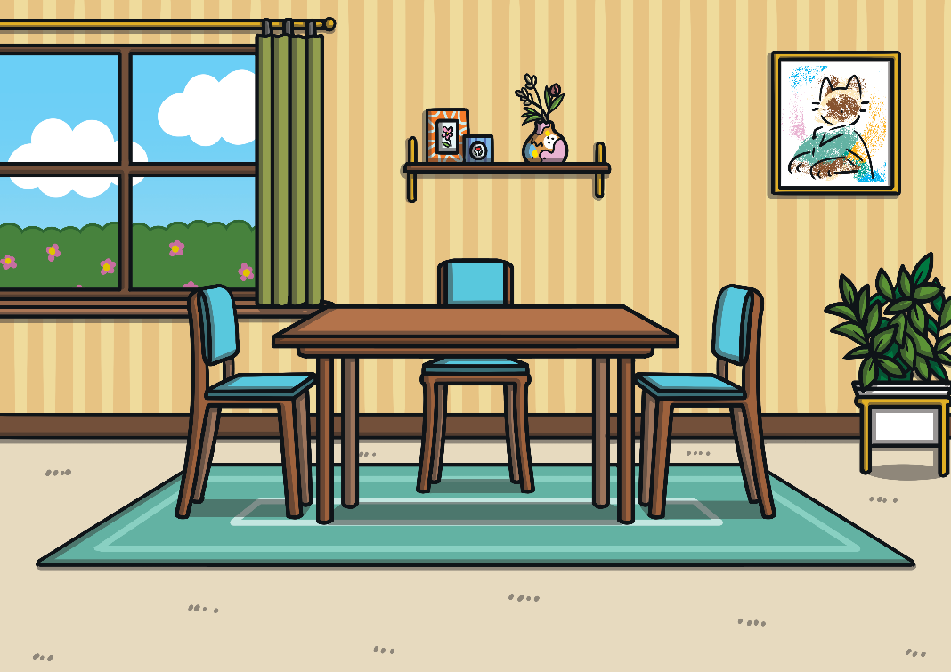
How do we say this in English?
?
dining room

Slide 7
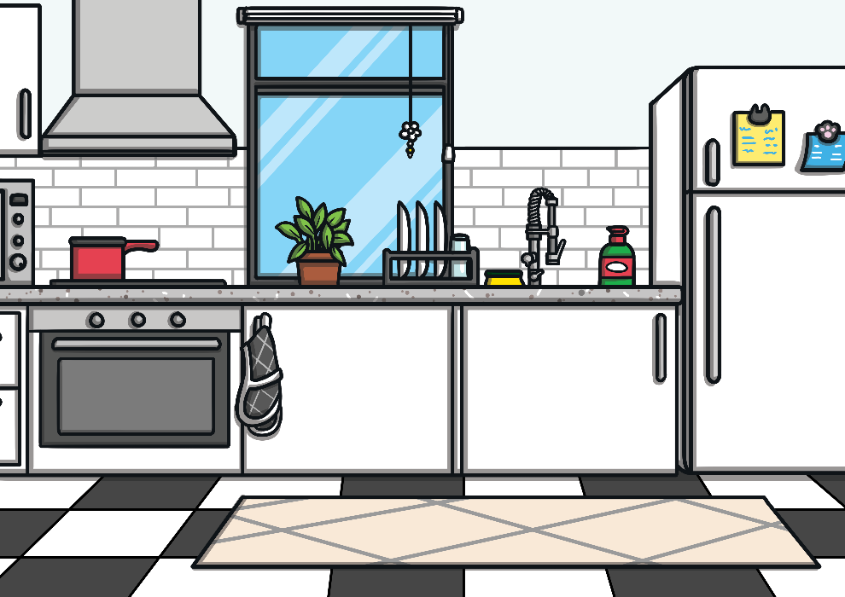
How do we say this in English?
kitchen
?

Slide 8
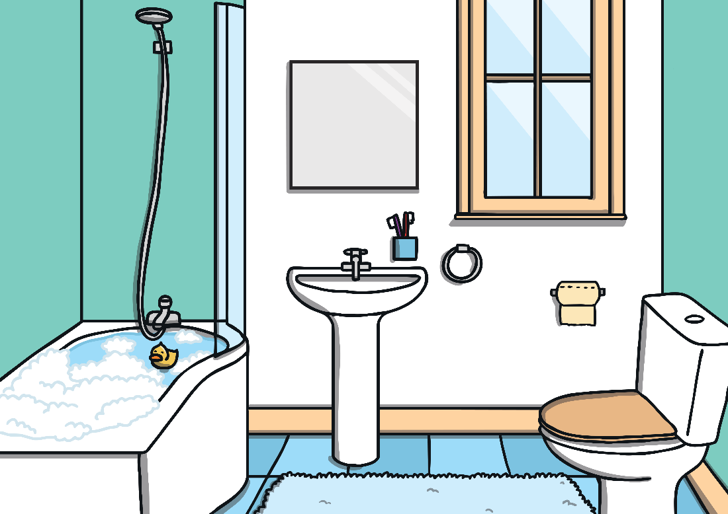
How do we say this in English?
?
bathroom

Slide 9
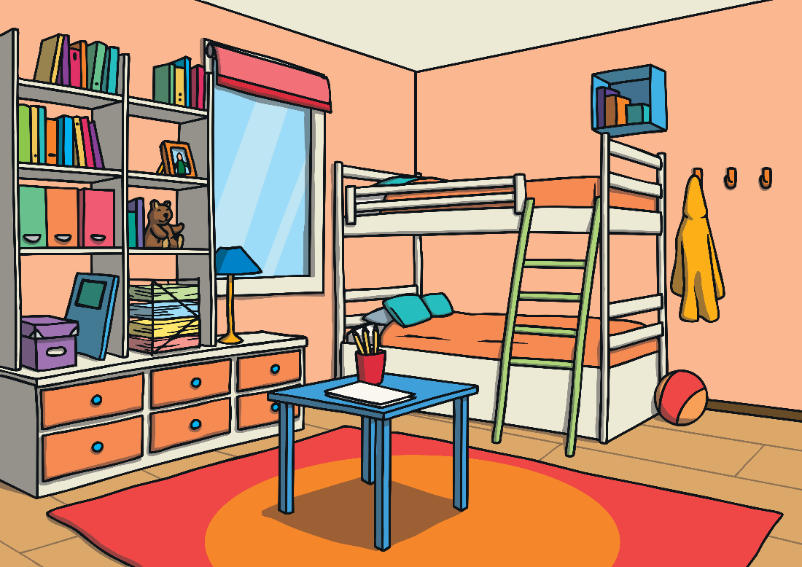
How do we say this in English?
bedroom
?

Slide 10

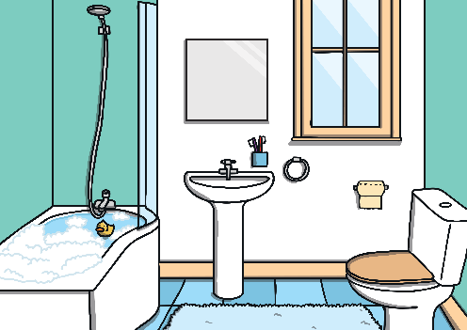

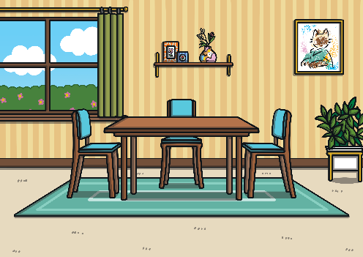
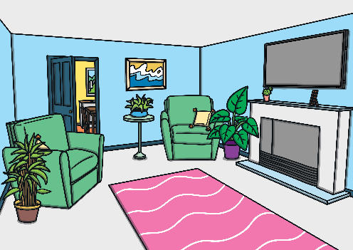
Let’s Practise
Can you remember how to say these words?
Click on the image to check.
kitchen
bathroom
bedroom
dining room
living room

Slide 11
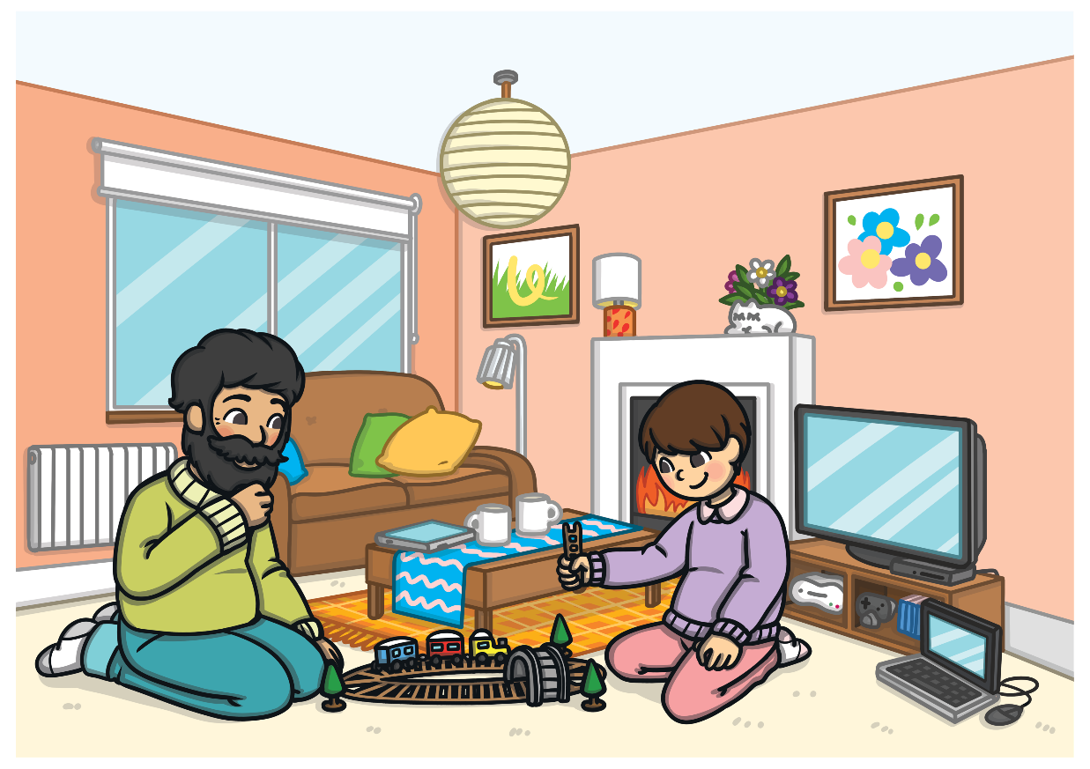
What room is this?
What can you see? Click ‘Answer’ to check.
Answer
living room

Slide 12
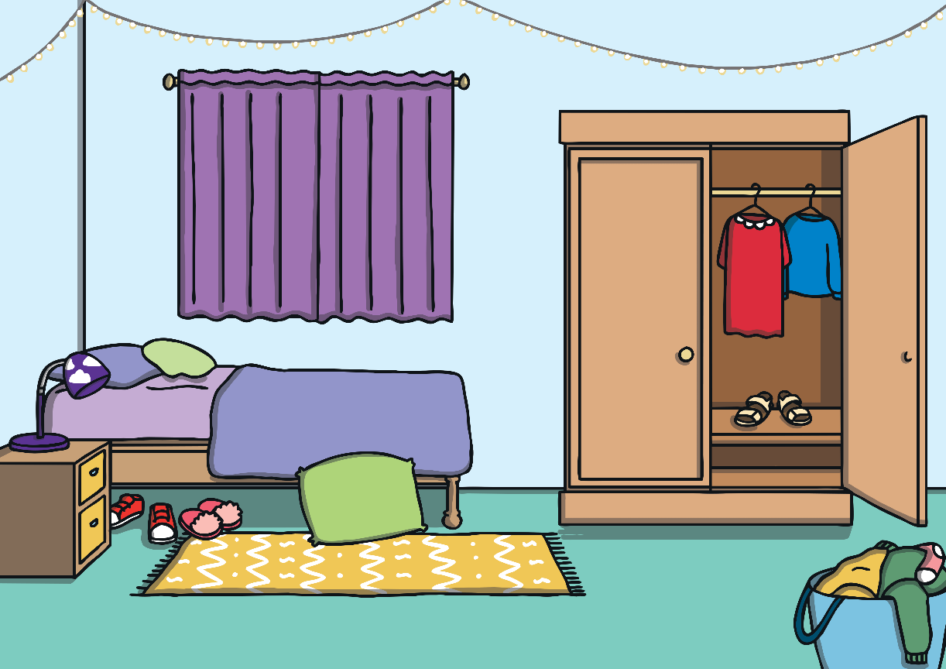
What room is this?
What can you see? Click ‘Answer’ to check.
Answer
bedroom

Slide 13
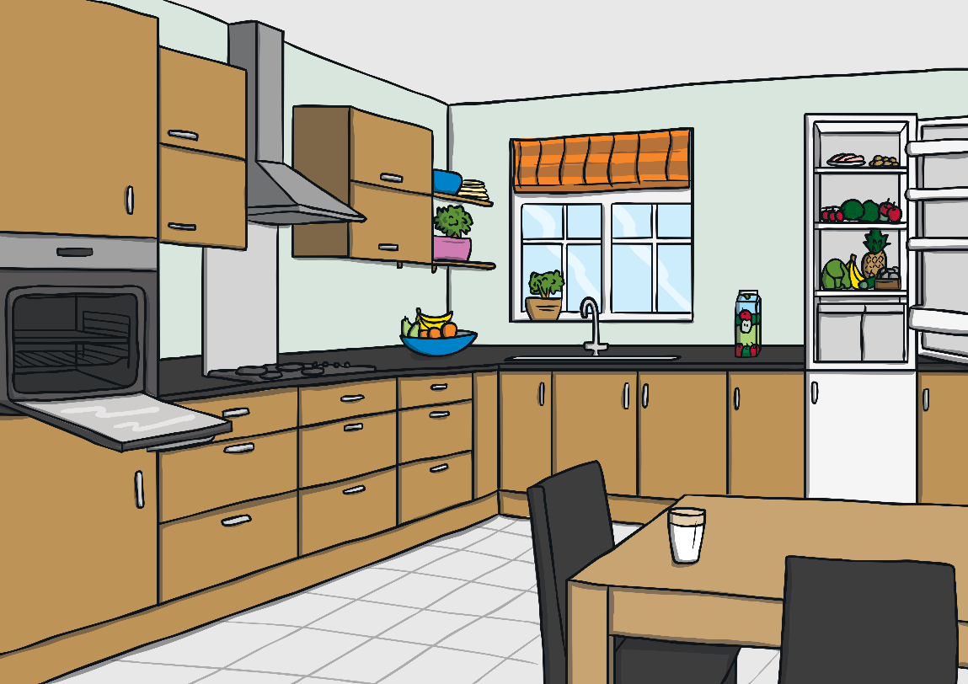
What room is this?
What can you see? Click ‘Answer’ to check.
Answer
kitchen

Slide 14
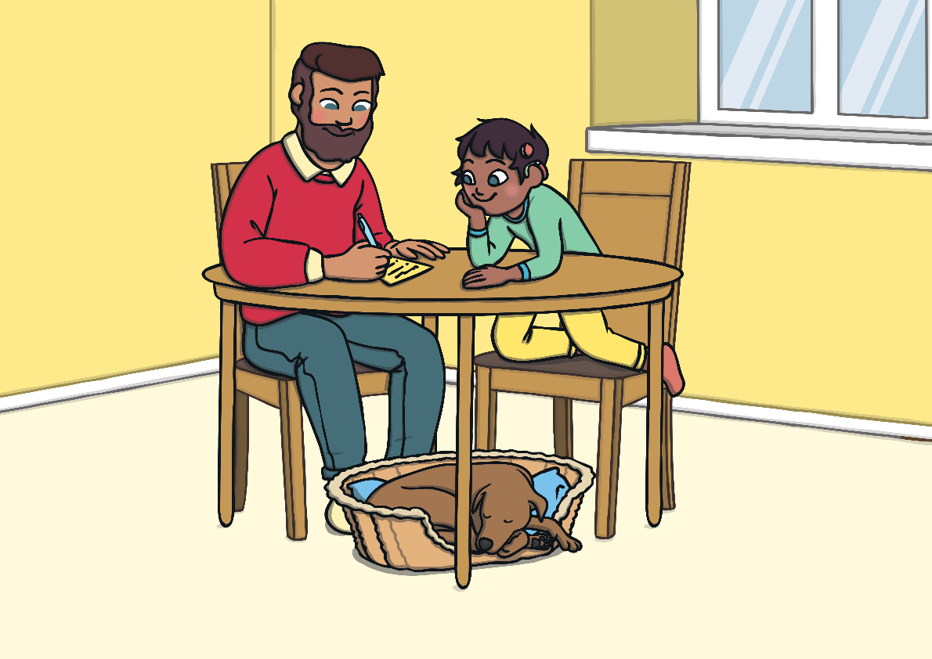
What room is this?
What can you see? Click ‘Answer’ to check.
Answer
dining room

Slide 15
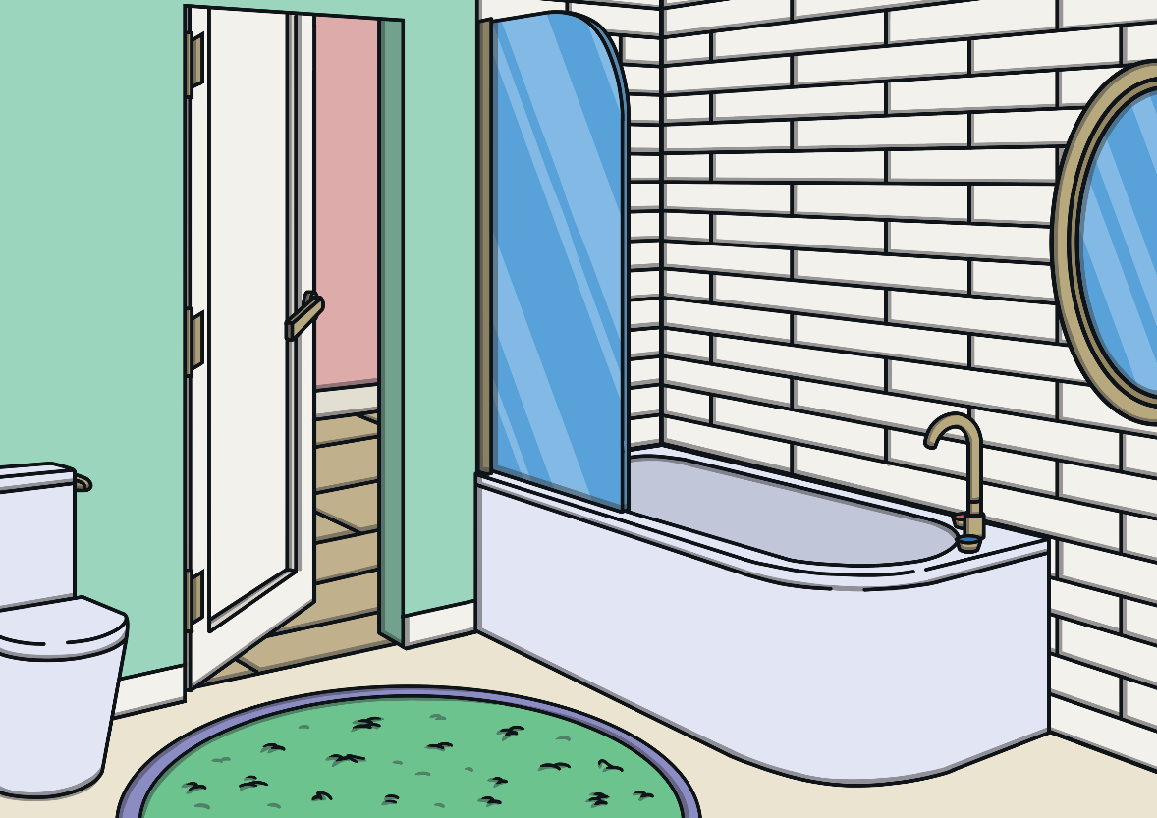
What room is this?
What can you see? Click ‘Answer’ to check.
Answer
bathroom

Slide 16
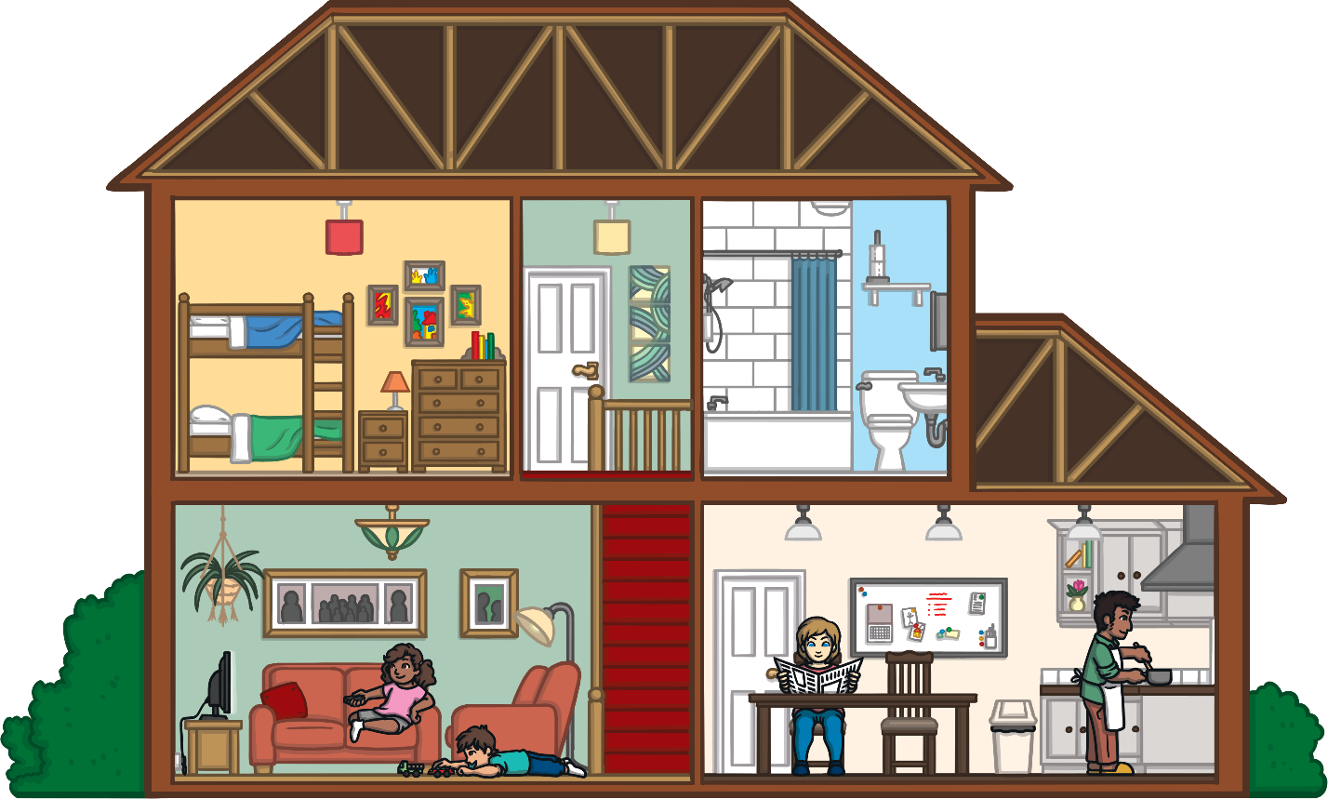
Where is the mum?
What can you see? Click ‘Answer’ to check.
Answer
dining room

Slide 17
Where is the dad?
What can you see? Click ‘Answer’ to check.
Answer
kitchen

Slide 18
Where are the brother and sister?
What can you see? Click ‘Answer’ to check.
Answer
living room

Slide 19
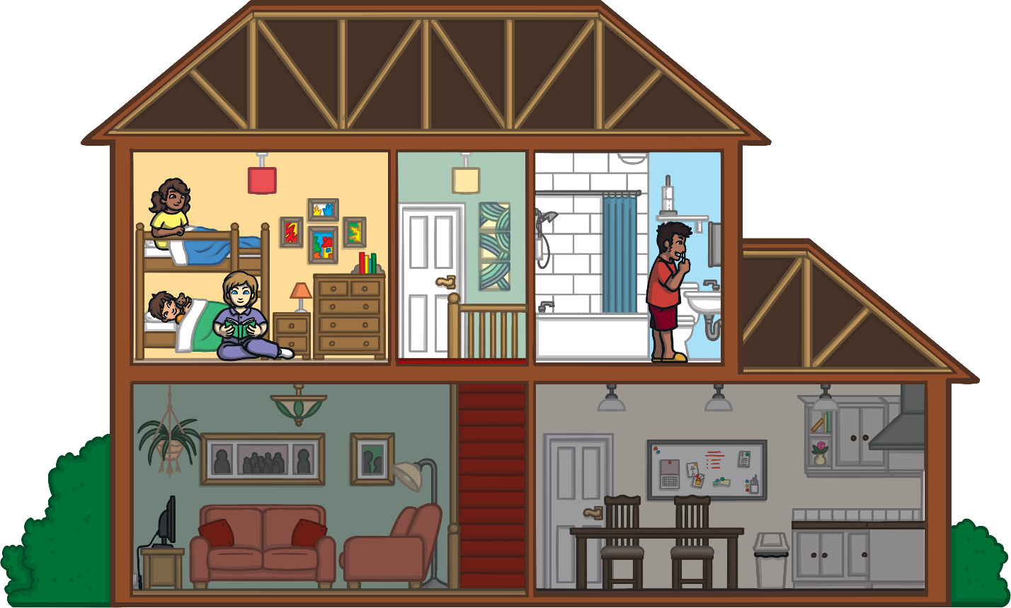
Where is the mum?
What can you see? Click ‘Answer’ to check.
Answer
bedroom

Slide 20
Where is the dad?
What can you see? Click ‘Answer’ to check.
Answer
bathroom

Slide 21
Where are the brother and sister?
What can you see? Click ‘Answer’ to check.
Answer
bedroom

