Slide 2
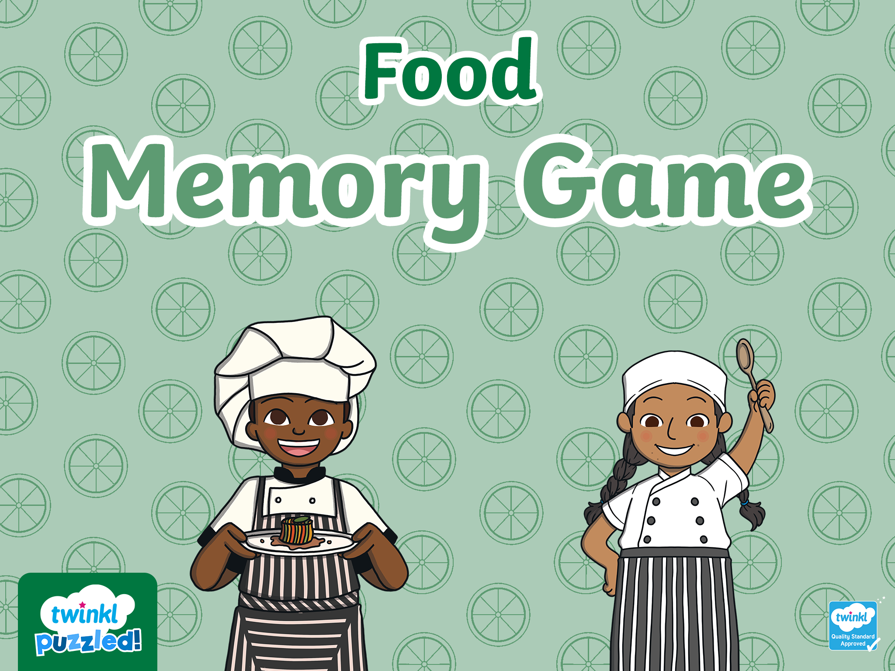
Start

Slide 3


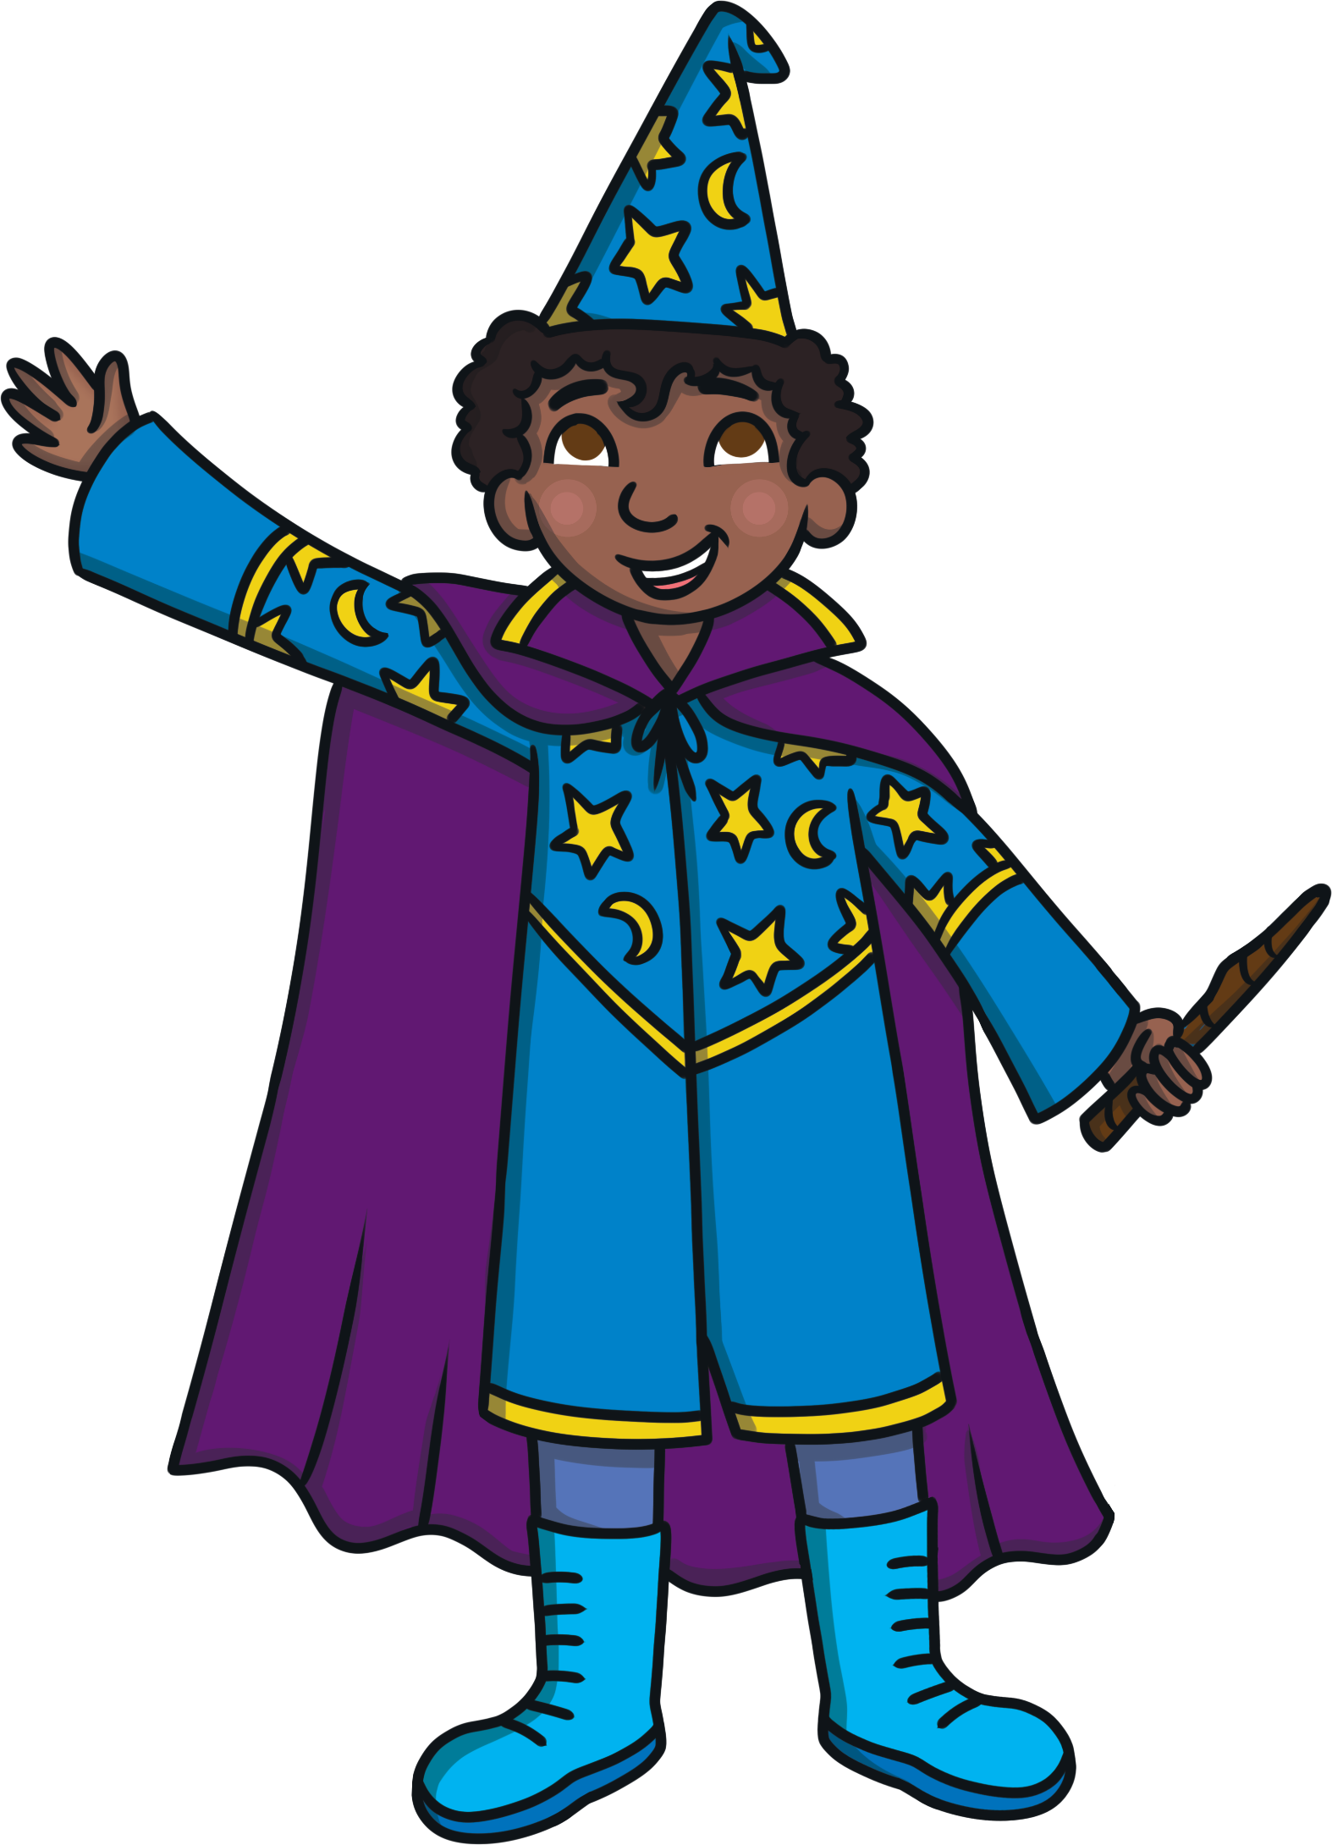
Abracadabra - one item has gone!
Can you remember and work out which one?
Start

Slide 4


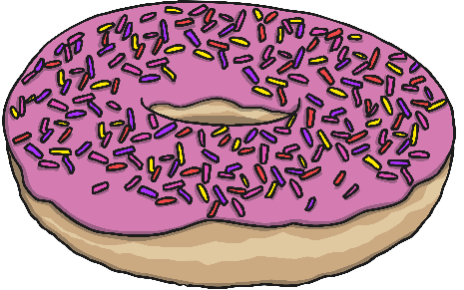
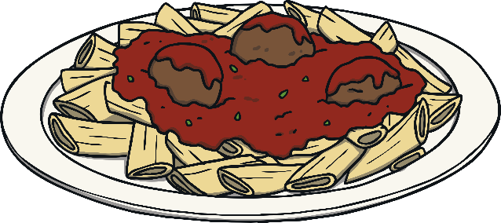



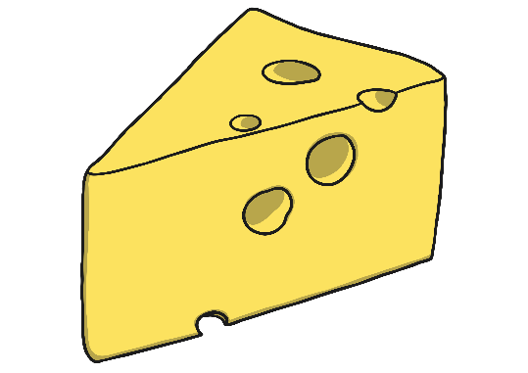
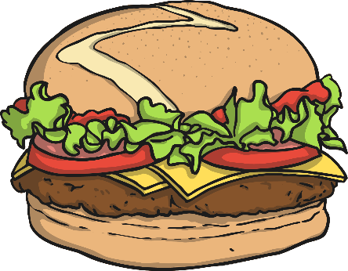
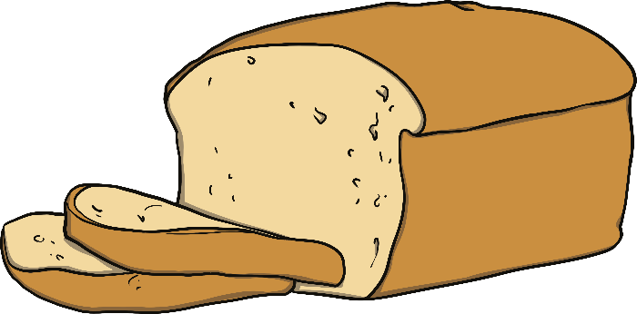
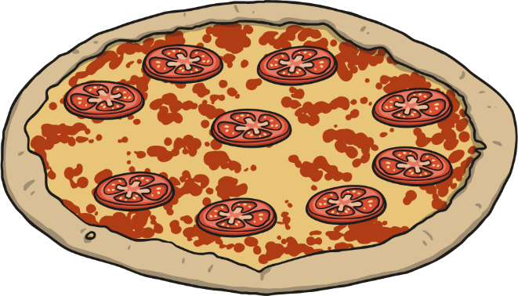
Memorise the items on the table
Ready?

Slide 5

Abracadabra!

Slide 6
What item is missing?
Reveal Answer

Slide 7
The cheese was missing!
Next

Slide 8
Memorise the items on the table
Ready?

Slide 9
Abracadabra!

Slide 10
What item is missing?
Reveal Answer

Slide 11
The doughnut was missing!
Next

Slide 12
Memorise the items on the table
Ready?

Slide 13
Abracadabra!

Slide 14
What item is missing?
Reveal Answer

Slide 15
The pizza was missing!
Next

Slide 16
