Slide 3
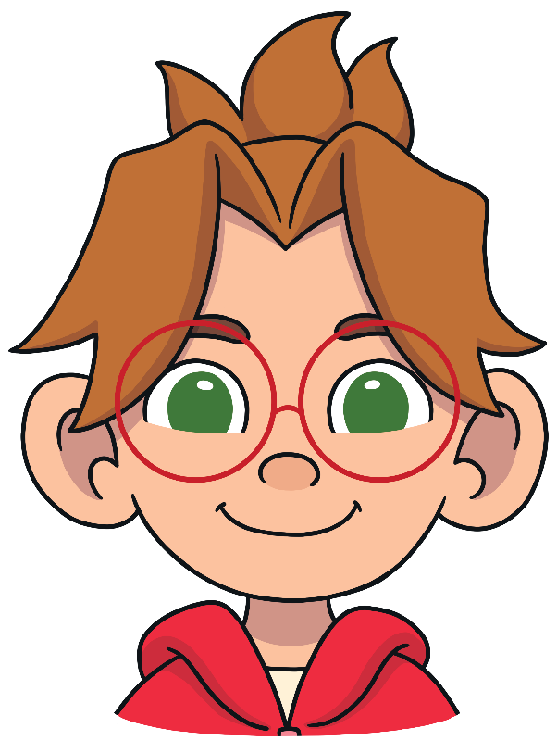
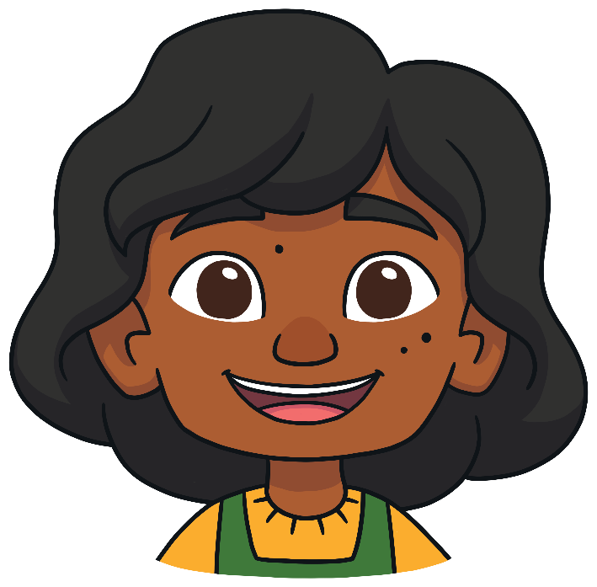
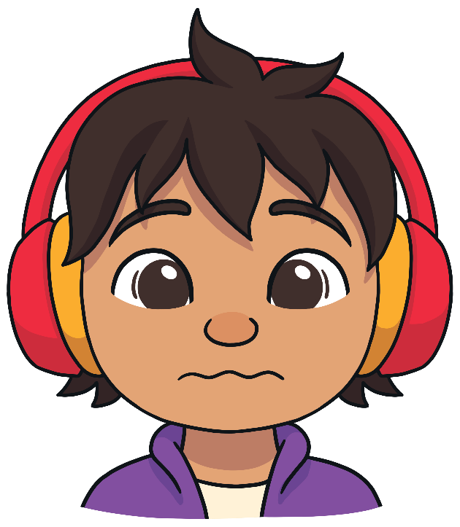
Instructions
Look at the picture. See if you can name what feeling or emotion each person is feeling.

Slide 4

What Am I Feeling?
Next
excited
sad
cross

Slide 5
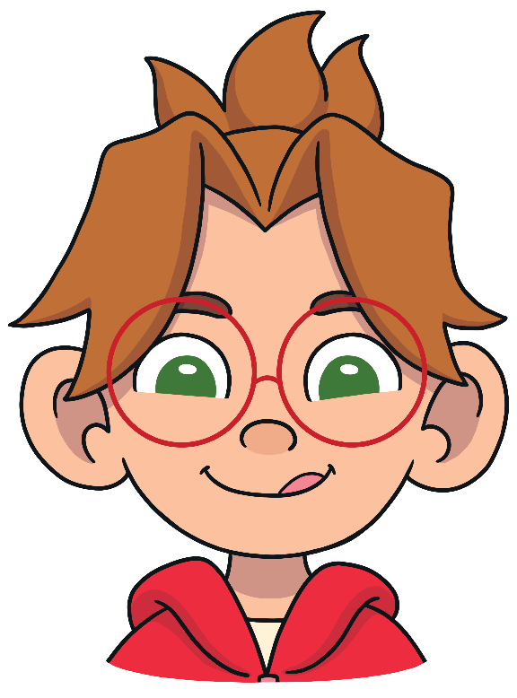
What Am I Feeling?
Next
nervous
happy
hungry

Slide 6

What Am I Feeling?
Next
upset
surprised
proud

Slide 7

What Am I Feeling?
Next
sad
bored
sleepy

Slide 8

What Am I Feeling?
Next
bored
scared
sick

Slide 9
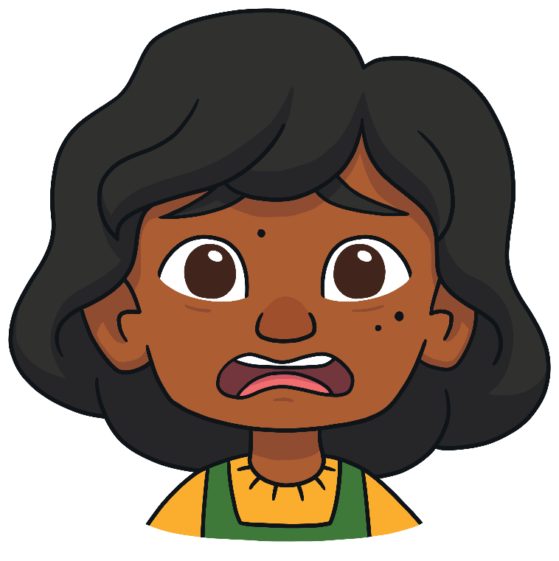
What Am I Feeling?
Next
dizzy
scared
surprised

Slide 10

What Am I Feeling?
Next
dizzy
jealous
hungry

Slide 11
What Am I Feeling?
Next
sleepy
worried
happy

Slide 12

What Am I Feeling?
Next
nervous
cross
excited

Slide 13
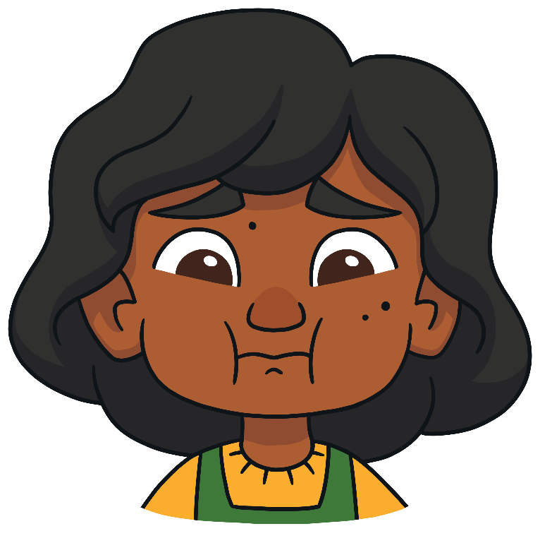
What Am I Feeling?
Next
happy
sick
sleepy

Slide 14

What Am I Feeling?
Next
bored
jealous
upset

Slide 15
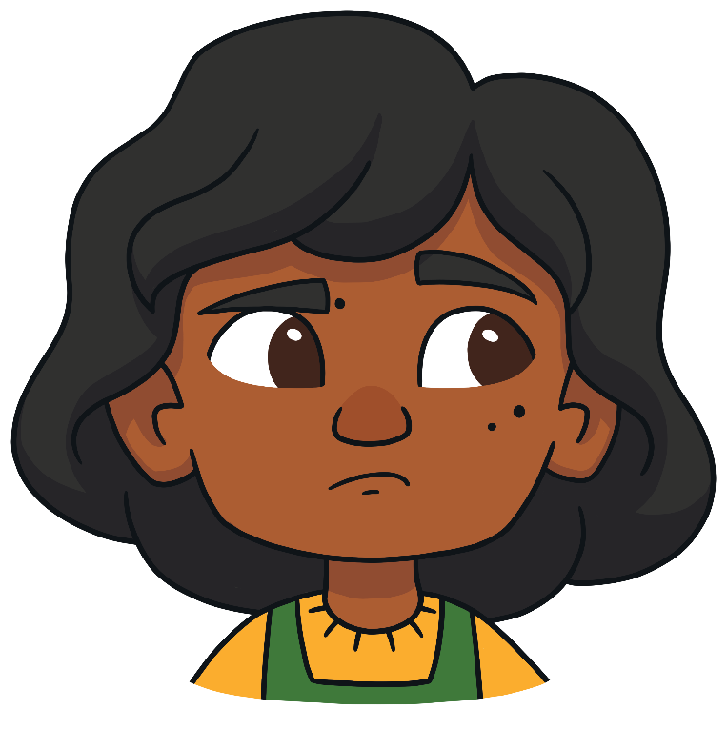
What Am I Feeling?
Next
scared
surprised
jealous

Slide 16

What Am I Feeling?
Next
sad
proud
dizzy

Slide 17
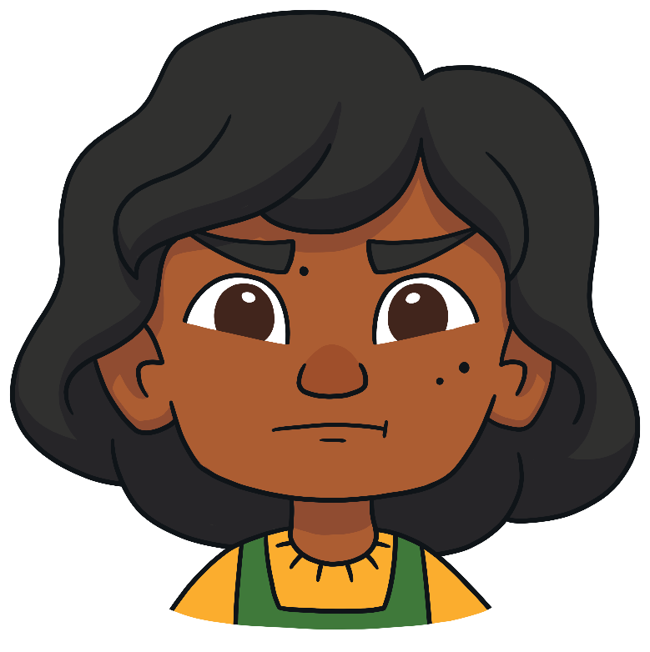
What Am I Feeling?
Next
cross
worried
sick

Slide 18

What Am I Feeling?
Next
excited
worried
hungry

Slide 19

What Am I Feeling?
Finish
upset
proud
nervous

