Slide 1
Guess Who?

Slide 2
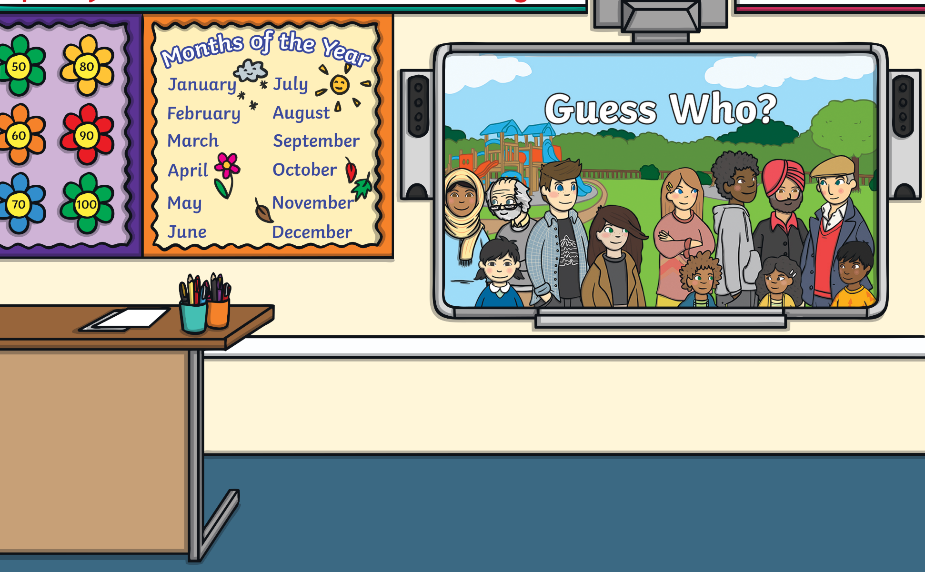

Instructions
The teacher picks a character.
Using the PowerPoint as reference, the class has to put their hands up and ask yes or no questions to eliminate characters till the correct character is found
To eliminate each character, click their card on the PowerPoint.

Slide 3
























Guess Who?
Ellie
Rubia
Paige
Julia
Shannon
Sophia

