Slide 4




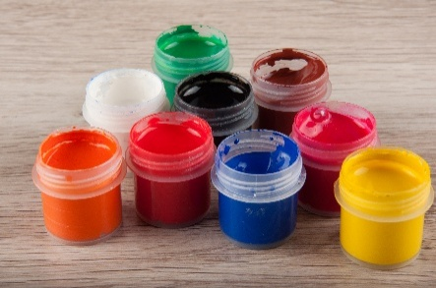




Revision
Click on the picture to reveal its name.
?
?
books
?
crayons
paper
paint
?
pencil
?
pen
?
?
rubber
?
ruler

Slide 5


Can you guess what is at school?
Click on the boxes to reveal the picture underneath.
Click on ‘Answer’ to reveal the answer.
Can you work out what it is?

Slide 6

Can you work out what it is?
5
3
9
12
1
10
13
6
15
8
14
2
7
4
11
16
books
Answer

Slide 7

Can you work out what it is?
8
1
15
2
3
7
10
5
12
14
9
11
16
13
4
6
crayons
Answer

Slide 8

Can you work out what it is?
11
2
10
4
6
15
14
7
13
9
5
1
3
12
16
8
paper
Answer

Slide 9

Can you work out what it is?
9
3
7
1
14
11
16
15
6
13
5
2
10
4
12
8
Answer
paint

Slide 10

Can you work out what it is?
8
2
9
7
11
3
12
5
10
4
1
6
pencil
Answer

Slide 11

Can you work out what it is?
5
3
9
12
1
10
13
6
15
8
14
2
7
4
11
16
pen
Answer

Slide 12

Can you work out what it is?
8
12
9
7
11
1
2
5
6
4
3
10
rubber
Answer

Slide 13
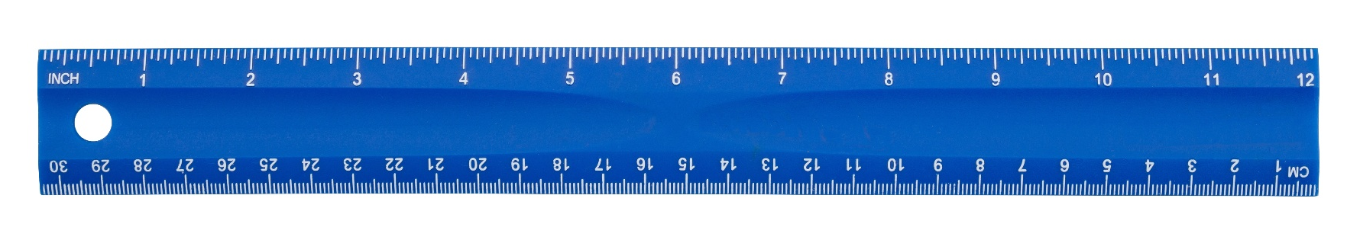
Can you work out what it is?
11
2
10
4
6
15
14
7
13
9
5
1
3
12
16
8
ruler
Answer

Slide 14


Twinkl's Ready-made ESL Curriculum
Online Games
Confidently teach ESL while saving time with our comprehensive set of learning materials, including ready-made PPT lessons with audio. Whether you require complete lesson plans or seek inspiration for warm-up exercises or additional activities, our Curriculum includes lesson plans tailored for every level.
Explore our ESL Curriculum Games App, featuring a variety of interactive vocabulary and grammar games aligned with our curriculum lessons.
Click here to empower your students to play, learn, and earn rewards.
Want to know more? Click me!

