Slide 1
Disclaimers
We hope you find the information on our website and resources useful.
ESL Disclaimer
This resource has been made for the purpose of teaching English language learners. We know that students can be learning English in many different places, in many different ways and at any age, so we try to keep these resources as general as possible.
There are many acronyms associated with English language teaching. These include (but are not limited to) ELT, TEFL, EFL, ELL, EAL and ESOL. While the term ESL may not fully represent the linguistic backgrounds of all students, it is the most widely recognised term for English language teaching globally. Therefore, we use the term ‘ESL’ in the names of our resources to make them easy to find but they are suitable for any student learning to speak English.
Editable
This resource is editable and can be adapted to meet the needs of different children. Twinkl cannot be held responsible for any changes made once a resource has been downloaded. Please be aware that this content may have been edited and therefore
may no longer reflect our values.

Slide 3



How do we say this in English?
?
hair

Slide 4

How do we say this in English?
?
head

Slide 5

How do we say this in English?
?
body

Slide 6

How do we say this in English?
?
arms

Slide 7

How do we say this in English?
?
hands

Slide 8
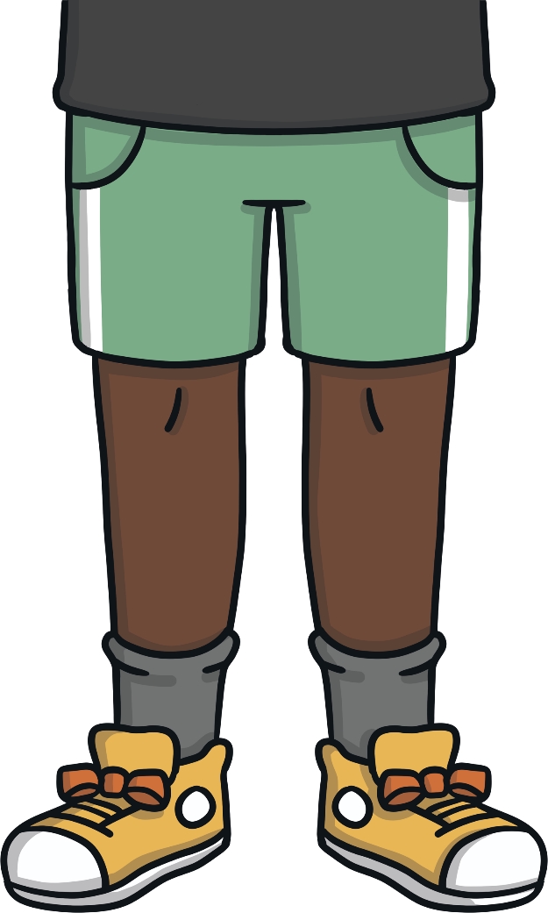
How do we say this in English?
?
legs

Slide 9
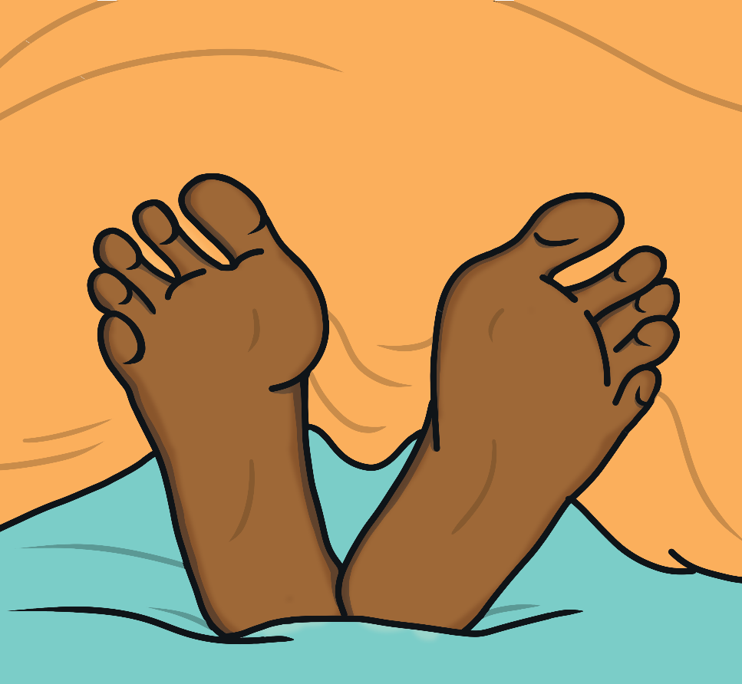
How do we say this in English?
?
feet

Slide 10





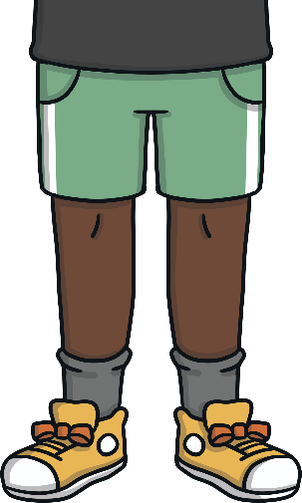
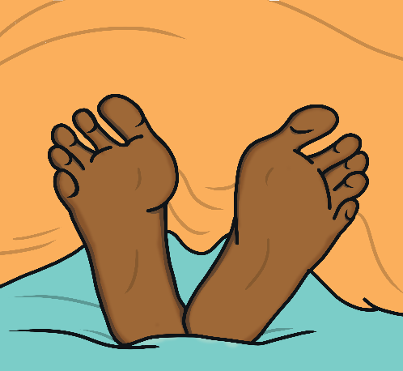
Let’s Practise
Can you remember how to say these words?
Click on the image to check.

Slide 11

What are these?
What can you see?
Click ‘Answer’ to check.
Answer
?
?
Answer
?
?
?
?
hands

Slide 12

What is this?
What can you see?
Click ‘Answer’ to check.
Answer
?
?
Answer
?
?
?
?
head

Slide 13
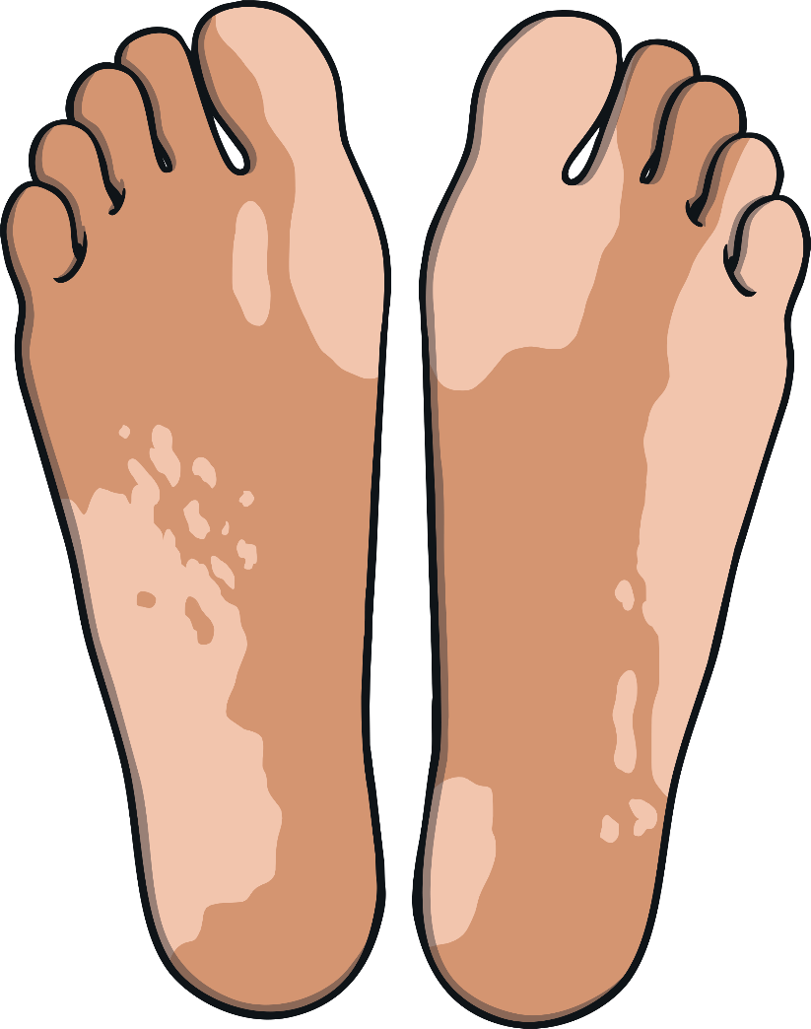
What are these?
What can you see?
Click ‘Answer’ to check.
Answer
?
?
Answer
?
?
?
?
feet

Slide 14

What are these?
What can you see?
Click ‘Answer’ to check.
Answer
?
?
Answer
?
?
?
?
arms

Slide 15

What is this?
What can you see?
Click ‘Answer’ to check.
Answer
?
?
Answer
?
?
?
?
hair

Slide 16
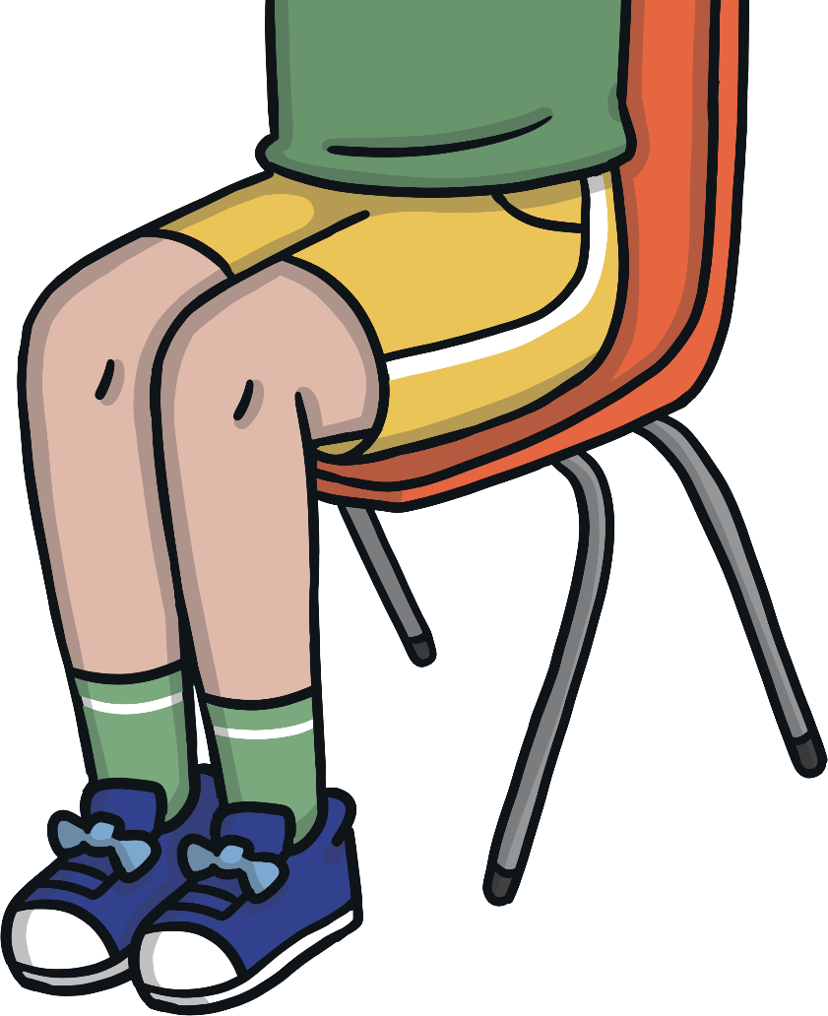
What are these?
What can you see?
Click ‘Answer’ to check.
Answer
?
?
Answer
?
?
?
?
legs

Slide 17
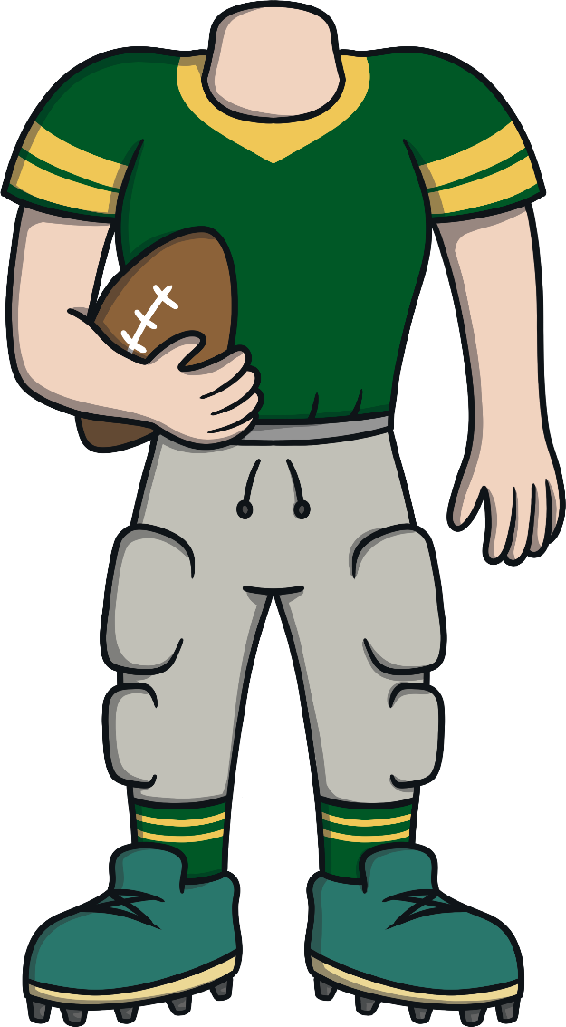
What is this?
What can you see?
Click ‘Answer’ to check.
Answer
?
?
Answer
?
?
?
?
body

