Slide 3
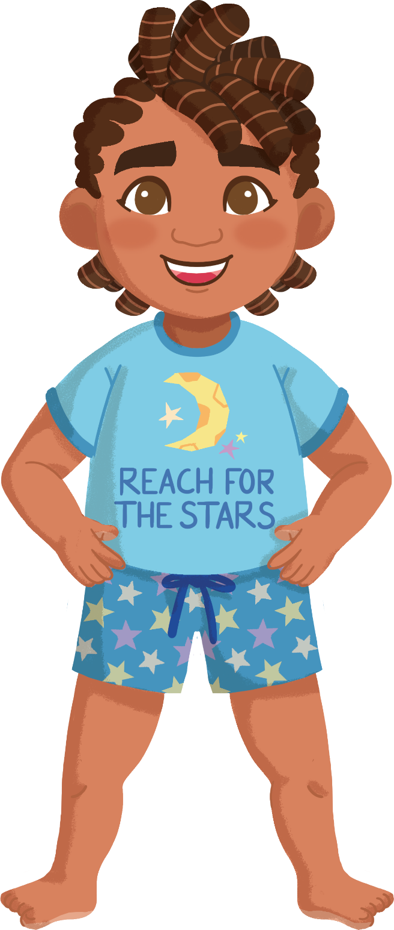

Label the
Human Body
head
?
foot
belly
head
Next

Slide 4
Label the
Human Body
head
?
hair
hand
hair
chest
Next

Slide 5
Label the
Human Body
head
hair
leg
eye
?
belly
eye
Next

Slide 6
Label the
Human Body
head
hair
face
face
?
eye
arm
leg
Next

Slide 7
Label the
Human Body
head
hair
face
chest
eye
?
nose
hand
nose
Next

Slide 8
Label the
Human Body
head
hair
face
arm
eye
nose
?
ear
ear
eye
Next

Slide 9
Label the
Human Body
head
hair
face
mouth
eye
nose
ear
arm
?
mouth
hand
Next

Slide 10
Label the
Human Body
head
hair
face
leg
eye
nose
ear
foot
?
arm
mouth
arm
Next

Slide 11
Label the
Human Body
head
hair
face
leg
eye
nose
ear
belly
arm
mouth
chest
?
chest
Next

Slide 12
Label the
Human Body
head
hair
face
hair
eye
nose
ear
hand
arm
mouth
foot
hand
?
chest
Next

Slide 13
Label the
Human Body
head
hair
face
arm
eye
nose
ear
leg
arm
mouth
foot
hand
chest
?
leg
Next

Slide 14
Label the
Human Body
head
hair
face
belly
eye
nose
ear
head
arm
mouth
nose
hand
chest
leg
?
Next
belly

Slide 15
Label the
Human Body
head
hair
face
hand
eye
nose
ear
arm
arm
mouth
foot
hand
chest
leg
belly
Next
foot
?

Slide 16

Label the
Human Body
head
hair
Well done! You’ve labelled the main parts of the human body!
face
eye
nose
ear
arm
mouth
Do you know the names of any other body parts? Where are they on your body?
hand
chest
leg
belly
foot

