Slide 2
What Am I?
Can you follow the clues to work out which animal is being described?
Click on the leaves to reveal each clue!
Start

Slide 3
What Am I?
I have four legs.
I am big and grey.
Elephant
I have a trunk.
Previous
Click to reveal the answer.
Next

Slide 4
What Am I?
I have four legs.
I like to eat carrots.
Rabbit
I have two long ears.
Previous
Click to reveal the answer.
Next

Slide 5
What Am I?
I have four legs.
My coat is used for wool.
Sheep
I say ‘baaaaaa’.
Previous
Click to reveal the answer.
Next

Slide 6
What Am I?
I have four legs.
I look like a horse.
Zebra
I have black and white stripes.
Previous
Click to reveal the answer.
Next

Slide 7
What Am I?
I have no legs.
I slither and slide.
Snake
I say ‘hisssss’.
Previous
Click to reveal the answer.
Next

Slide 8
What Am I?
I have lots of legs.
I like to eat leaves.
Caterpillar
One day I will turn into a butterfly.
Previous
Click to reveal the answer.
Next

Slide 9
What Am I?
I live on a farm.
I like to eat grass.
Cow
I give milk.
Previous
Click to reveal the answer.
Next

Slide 10
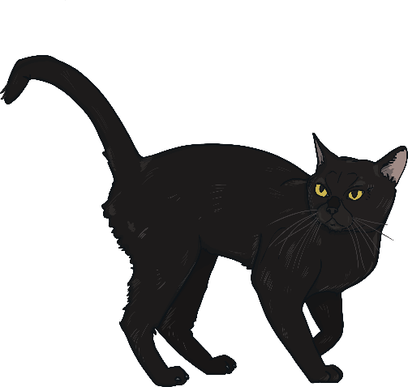
What Am I?
I have four legs.
I like to chase mice.
Cat
I say ‘miaow’.
Previous
Click to reveal the answer.
Next

Slide 11
What Am I?
I have four legs.
I love to go for walks.
Dog
I say ‘woof woof’.
Previous
Click to reveal the answer.
Next

Slide 12
What Am I?
I have four legs.
I like to eat leaves.
Giraffe
I have a very long neck.
Previous
Click to reveal the answer.
Next

Slide 13
What Am I?
I have eight legs.
I eat flies.
Spider
I live in a web.
Previous
Click to reveal the answer.
Next

Slide 14
What Am I?
I have six legs.
I can fly.
Ladybird
I am red with black spots.
Previous
Click to reveal the answer.
Next

