Slide 1
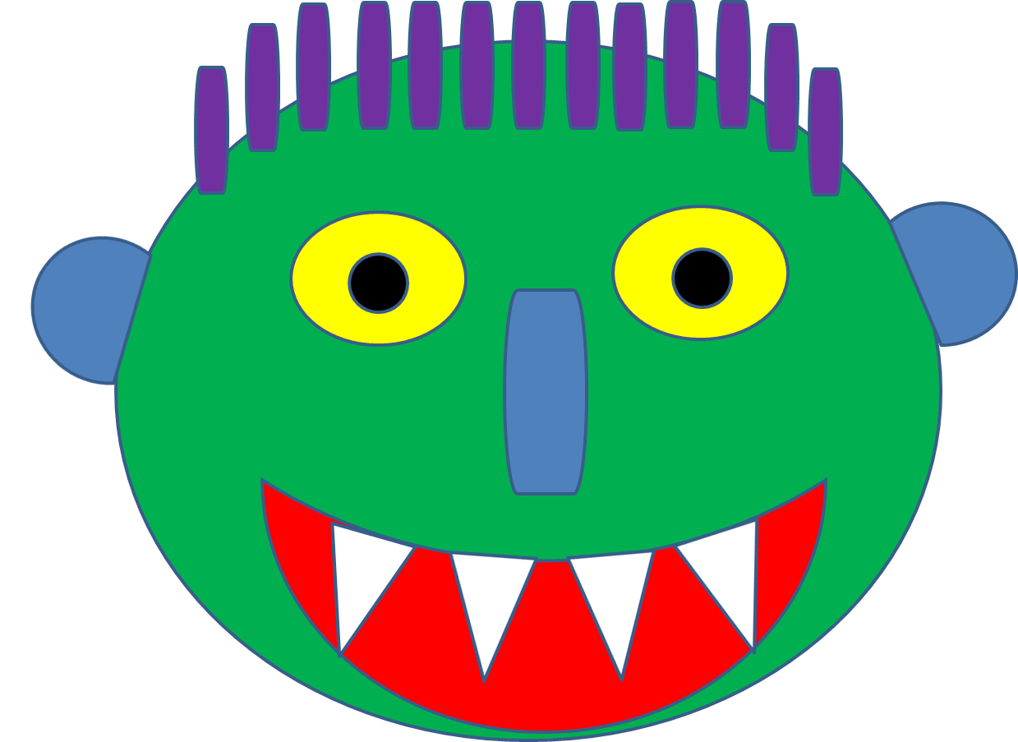

Slide 3
Big green monster
has two big, yellow eyes

Slide 4
A long bluish, greenish nose

Slide 5
A big red mouth with sharp white teeth

Slide 6
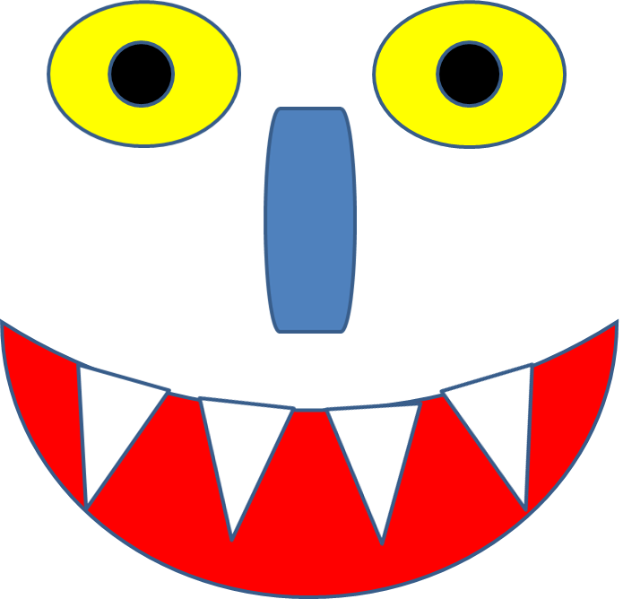
Two little squiggly ears

Slide 7
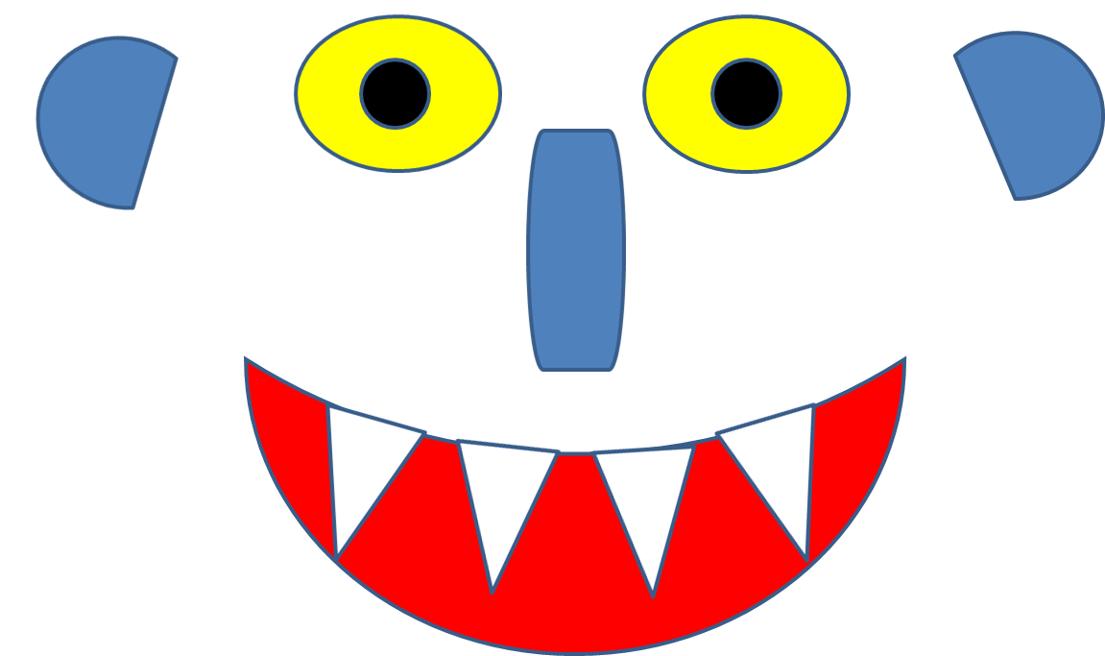
Scraggly purple hair

Slide 8
and a big scary green face! But…

Slide 9
YOU DON’T SCARE ME!
SO GO AWAY scraggly, purple hair

Slide 10
GO AWAY two little , squiggly ears

Slide 11
GO AWAY long, bluish-greenish nose

Slide 12
GO AWAY big, green face!

Slide 13
GO AWAY big red mouth!

Slide 14
GO AWAY sharp white teeth!

Slide 15
GO AWAY two, big yellow eyes

Slide 16
GO AWAY
BIG GREEN
MONSTER!!!

